Slide 1
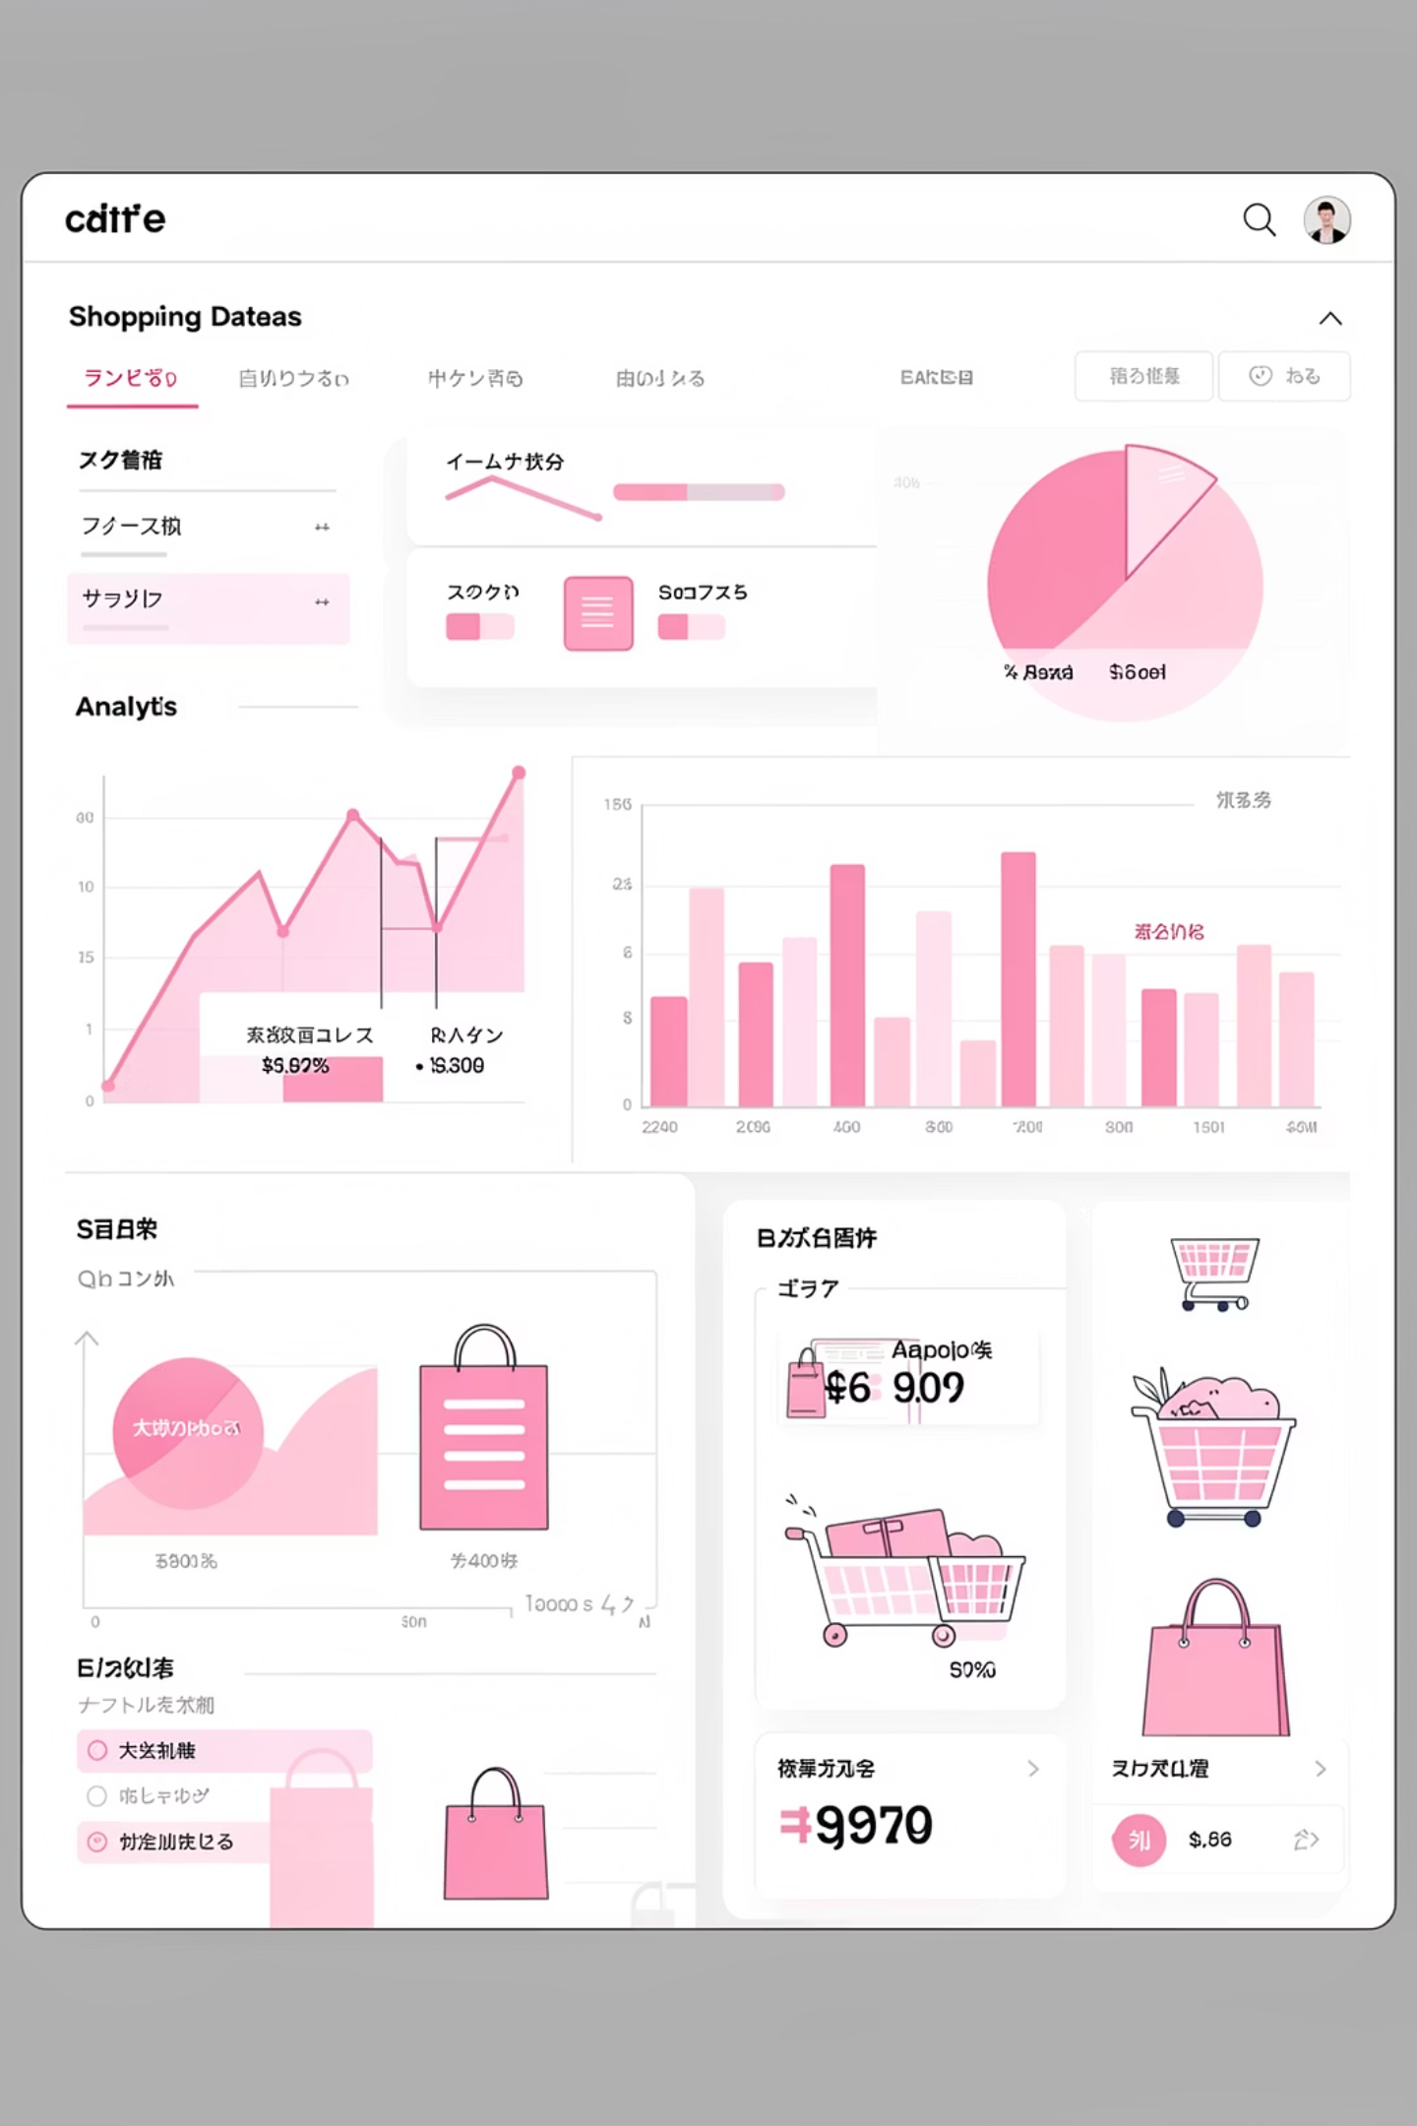
Customer Shopping Behavior Analysis
Uncovering spending patterns, customer segments & product preferences from 3,900 transactions

Slide 2
Dataset at a Glance
3,900
18
37
Purchases
Features
Missing Ratings
Demographics
Purchase Details
Behavior
Age, Gender, Location, Subscription
Item, Category, Amount, Size, Color
Season, Discounts, Frequency, Ratings, Shipping

Slide 3
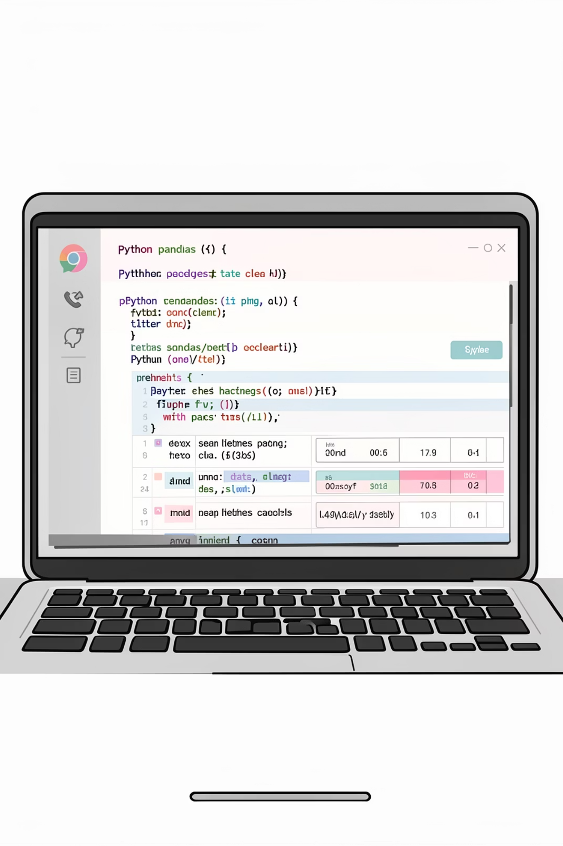
Data Preparation & Cleaning
01
Load & Explore
Imported with pandas; used head(), info(), describe()
02
Handle Missing Data
Imputed 37 missing review ratings using median per category
03
Feature Engineering
Created age_group & purchase_frequency_days columns
04
DB Integration
Loaded cleaned dataframe into SQL Server

Slide 4
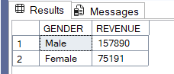
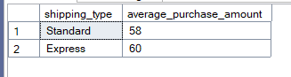
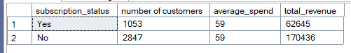
SQL Analysis: Revenue Insights
Revenue by Gender
Compared total revenue split across male and female customers.
Shipping Spend Gap
Average purchase amount compared between Standard vs. Express shipping.
Subscribers vs. Non-Subscribers
Measured average spend & total revenue for each group.

Slide 5
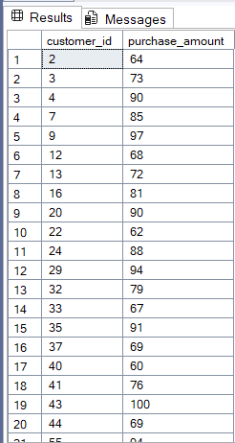
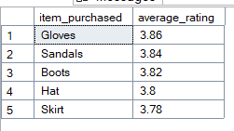
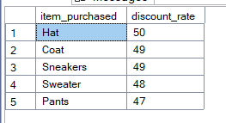
High-Value Customer Behaviors
Discount Power Users
Top-Rated Products
Discount Concentration
Customers who used discounts yet spent above average purchase amount
Top 5 products with review ratings above the overall average
Products with the highest % of discounts applied identified

Slide 6




Customer Segmentation by Age
Young Adult
Adult
Middle-Aged
Senior
Revenue distribution analyzed across all four age groups to identify high-value segments.

Slide 7
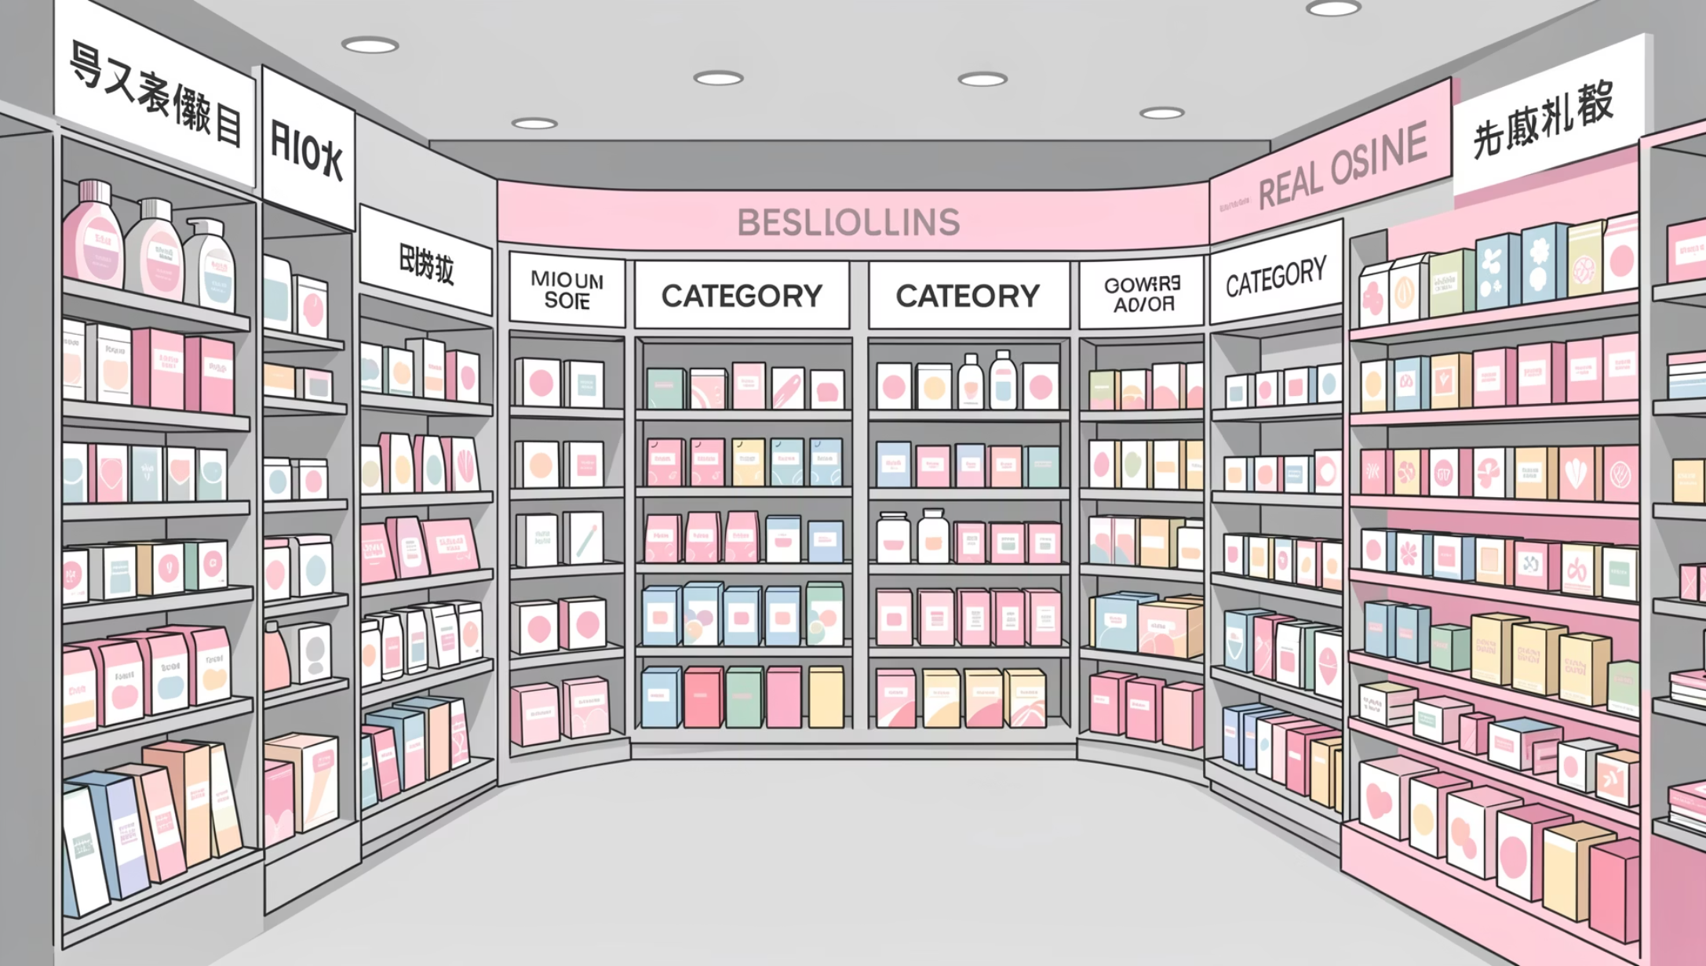
Product & Category Performance
Top 3 Per Category
Highest-selling products identified within each product category.
Repeat Buyers
Customers with 5+ orders segmented by subscription status.

Slide 8
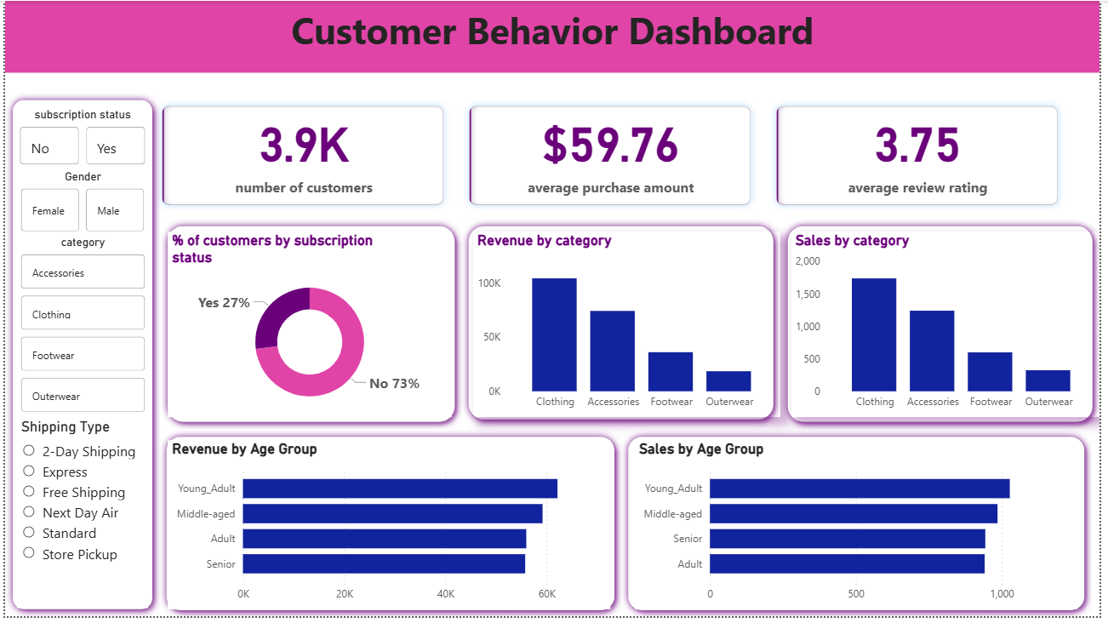
Power BI Dashboard

Slide 9




Business Recommendations
Boost Subscriptions
Loyalty Program
Promote exclusive subscriber benefits
Reward repeat buyers to grow "Loyal" segment
Review Discounts
Target Marketing
Balance sales boosts with margin control
Focus on high-revenue age groups & express-shipping users

Slide 10

Key Takeaways
Data-Driven
Actionable Segments
3,900 transactions cleaned, engineered & analyzed end-to-end
Age, subscription & frequency segments reveal clear revenue drivers
Strategic Growth
Loyalty, discounts & product positioning guide next steps

